Slide 1

Real Estate Price Prediction Project

Slide 2
Basic information about the team and guide:
Team :
GUiDE
Mihir Y Patel – 180050131073
Raj Patel – 180050131079
Jainish N Shah - 180050131107
Name : Dr. Nandini M. Chaudhari

Slide 3
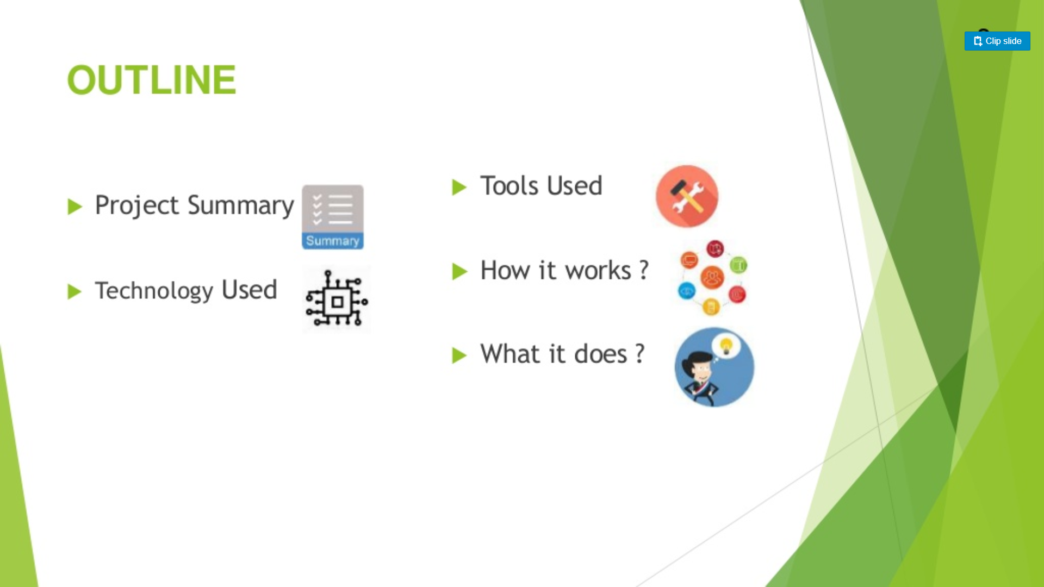

Slide 4
Introduction
Problems faced during buying a house:
Depending parameters:
Project Summary

Slide 5


Slide 6
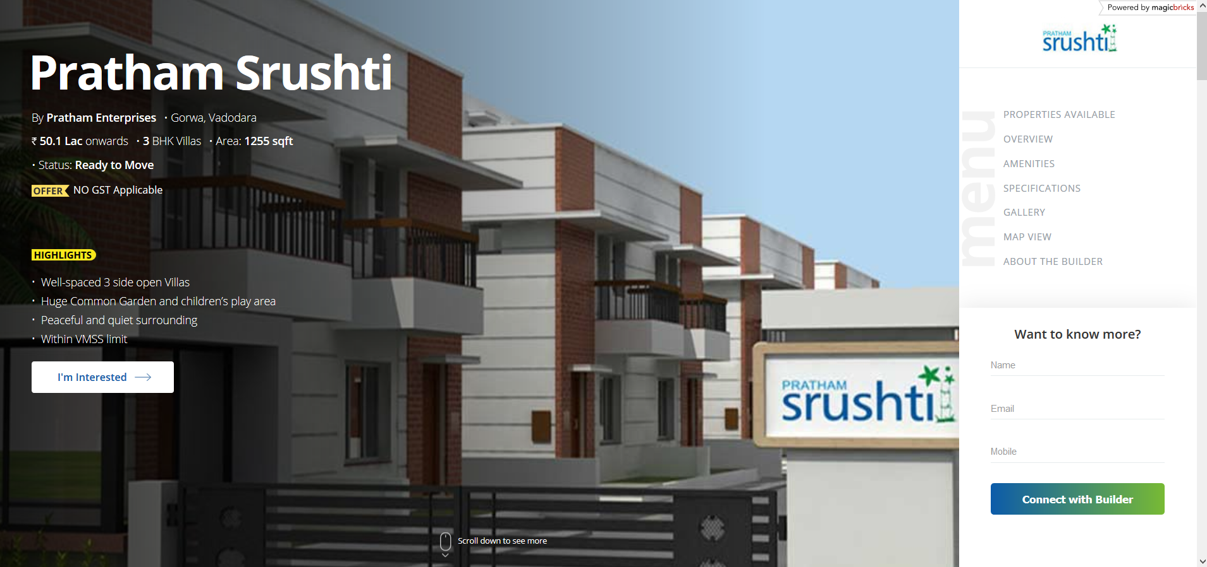

Slide 7
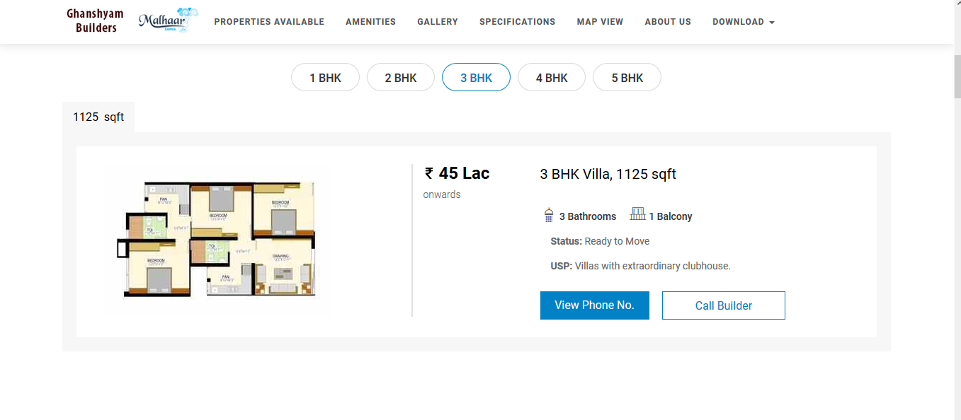

Slide 8
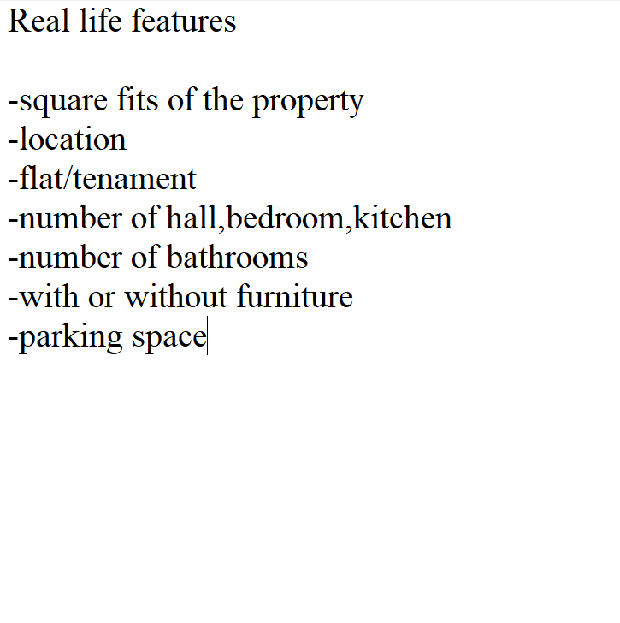

Slide 9


Slide 10
How it Works ?
COLLECTING DATA : First step of any project is like requirement elicitation that is DATA GATHERING in our project
ANALYZE DATA : That includes everything starting from Data Cleaning -> Checking Correlation between parameters, Remove Outliers and improving efficiency of dataset
Then we will train the model using MACHINE LEARNING ALGORITHM
And last based on the generated graphs we will PREDICT THE COST OF THE ESTATE

Slide 11
Gathering Data
Analyze Data
Remove outliers from dataset
Evaluating the model’s Performance – Grid Search
Dimensionally Reduction
Choose a regression machine learning algorithm
Real Estate Price

Slide 12
Advantage and Future Scope
Advantage :
The cost of the intermediate broker is reduced to zero…
Without any visit to different places one can have price prediction of a plot one is interested in..
Future Scope:
In real world scenario, we can use such a model to predict real estate price. This model should check for data, once in a month, and incorporate them to expand the dataset and produce better results.

Slide 13
THANK YOU

